Slide 1
Computer System Operation

Slide 2
System Startup
On power up
everything in system is in random, unpredictable state
special hardware circuit raises RESET pin of CPU
sets the program counter to 0xfffffff0
this address is mapped to ROM (Read-Only Memory)
BIOS (Basic Input/Output Stream)
set of programs stored in ROM
some OS’s use only these programs
MS DOS
many modern systems use these programs to load other system programs
Windows, Unix, Linux

Slide 3
BIOS
General operations performed by BIOS
1) find and test hardware devices
- POST (Power-On Self-Test)
2) initialize hardware devices
- creates a table of installed devices
3) find boot sector
- may be on floppy, hard drive, or CD-ROM
4) load boot sector into memory location 0x00007c00
5) sets the program counter to 0x00007c00
- starts executing code at that address

Slide 4
Boot Loader
Small program stored in boot sector
Loaded by BIOS at location 0x00007c0
Configure a basic file system to allow system to read from disk
Loads kernel into memory
Also loads another program that will begin kernel initialization

Slide 5
Initial Kernel Program
Determines amount of RAM in system
uses a BIOS function to do this
Configures hardware devices
video card, mouse, disks, etc.
BIOS may have done this but usually redo it
portability
Switches the CPU from real to protected mode
real mode: fixed segment sizes, 1 MB memory addressing, and no segment protection
protected mode: variable segment sizes, 4 GB memory addressing, and provides segment protection
Initializes paging (virtual memory)

Slide 6
Final Kernel Initialization
Sets up page tables and segment descriptor tables
these are used by virtual memory and segmentation hardware
Sets up interrupt vector and enables interrupts
Initializes all other kernel data structures ( Linked lists, Binary search trees, Bitmaps etc.)
Creates initial process and starts it running
init in Linux
smss (Session Manager SubSystem) in NT

Slide 7
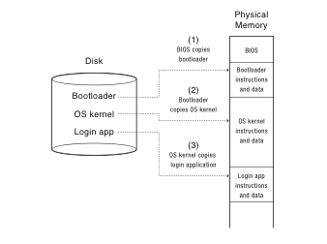
Booting
Notes:
When you power up a computer, what happens? Starts executing instructions. Why not start running the OS in step 1?
Why does the BIOS load the bootloader?
When the OS starts running, are interrupts enabled?
When will it be possible to start displaying things to the screen? Or console.
OS/161 – you start running the OS kernel after the bootloader has loaded it.
Why not just start running the app in the kernel?
Kind of inconvenient if you have to reboot all the time, just to change the app!
Also, could allow the app to access data on disk that it doesn’t have permission to do, etc.

Slide 8
System Programs
Application programs included with the OS
Highly trusted programs
Perform useful work that most users need
listing and deleting files, configuring system
ls, rm, Windows Explorer and Control Panel
may include compilers and text editors
Not part of the OS
run in user space
Very useful

Slide 9
Operating-System Operations
Interrupt driven by hardware
Software error or request creates exception or trap
Division by zero, request for operating system service
Other process problems include infinite loop, processes modifying each other or the operating system
Dual-mode operation allows OS to protect itself and other system components
Hardware provides at least two modes:
“Kernel” mode (or “supervisor” or “protected”)
“User” mode: Normal programs executed
Mode bit provided by hardware
Provides ability to distinguish when system is running user code or kernel code
Some instructions designated as privileged, only executable in kernel mode
System call changes mode to kernel, return from call resets it to user

Slide 10
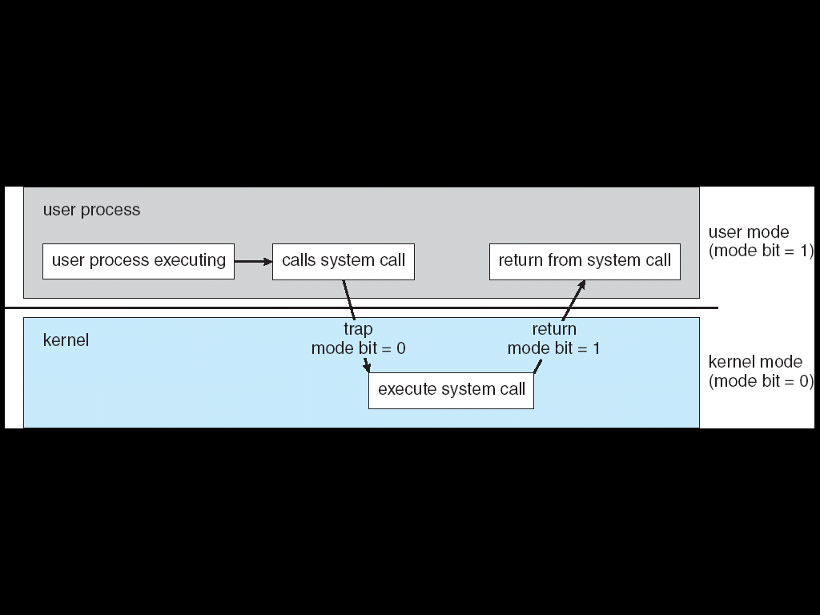
Dual Mode Operation
Some instructions/ops prohibited in user mode:
Example: cannot modify page tables in user mode
Attempt to modify ⇒ Exception generated
Transitions from user mode to kernel mode:
System Calls, Interrupts, Other exceptions

Slide 11
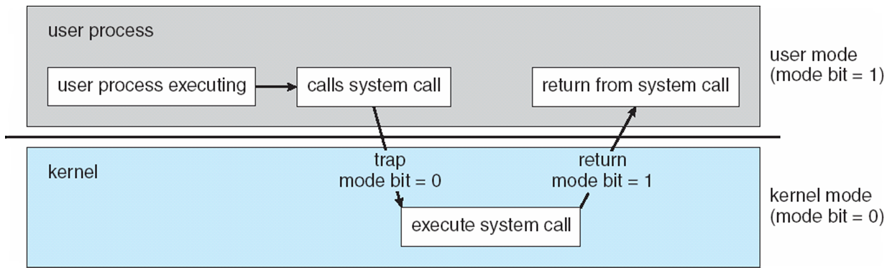
Transition from User to Kernel Mode
Timer to prevent infinite loop / process hogging resources
Set interrupt after specific period
Operating system decrements counter
When counter zero generate an interrupt
Set up before scheduling process to regain control or terminate program that exceeds allotted time

Slide 12
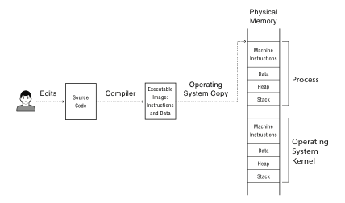
Notes:
OK, so you compile your program into an executable image with instructions and data.
Which of these is the program? How does it start running? Well, if its Javascript – no compilation step! Just interprets the source code.
If its Android, then its compiled into a byte code that is interpreted in software – well, actually, interpreted into short snippets of instructions, with jumps back into the interpreter when done.
If it’s attu, then compiled into x86 instructions.
What’s to keep the process from overwriting the OS kernel? Or some other process running at the same time?
What’s to keep it from overwriting the disk? From reading someone else’s files that are stored on disk?

Slide 13
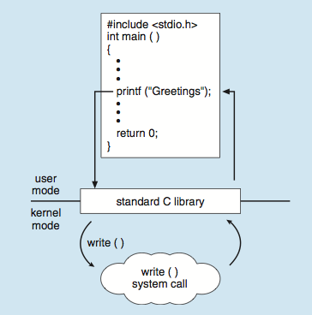
Standard C Library Example
C program invoking printf() library call, which calls write() system call

Slide 14
System Calls
System calls provide the interface between a running program and the operating system.
Generally available as assembly-language instructions.
Languages have been defined to replace assembly language for systems programming; allow system calls to be made directly (e.g., C, C++)
Three general methods are used to pass parameters between a running program and the operating system.
Pass parameters in registers.
Store the parameters in a table in memory, and the table address is passed as a parameter in a register.
Push (store) the parameters onto the stack by the program, and pop off the stack by operating system.
Notes:
System call provides the services of the operating system to the user programs via Application Program Interface(API)
In computing, a system call (commonly abbreviated to syscall) is the programmatic way in which a computer program requests a service from the kernel of the operating system on which it is executed.

Slide 15
System Calls
System calls are routines run by the OS on behalf of the user
Allow user to access I/O, create processes, get system information, etc.
Programming interface to the services provided by the OS
Typically written in a high-level language (C or C++)
Mostly accessed by programs via a high-level Application Programming Interface (API) rather than direct system call use
Three most common APIs are Win32 API for Windows, POSIX API for POSIX-based systems (including virtually all versions of UNIX, Linux, and Mac OS X), and Java API for the Java virtual machine (JVM)

Slide 16
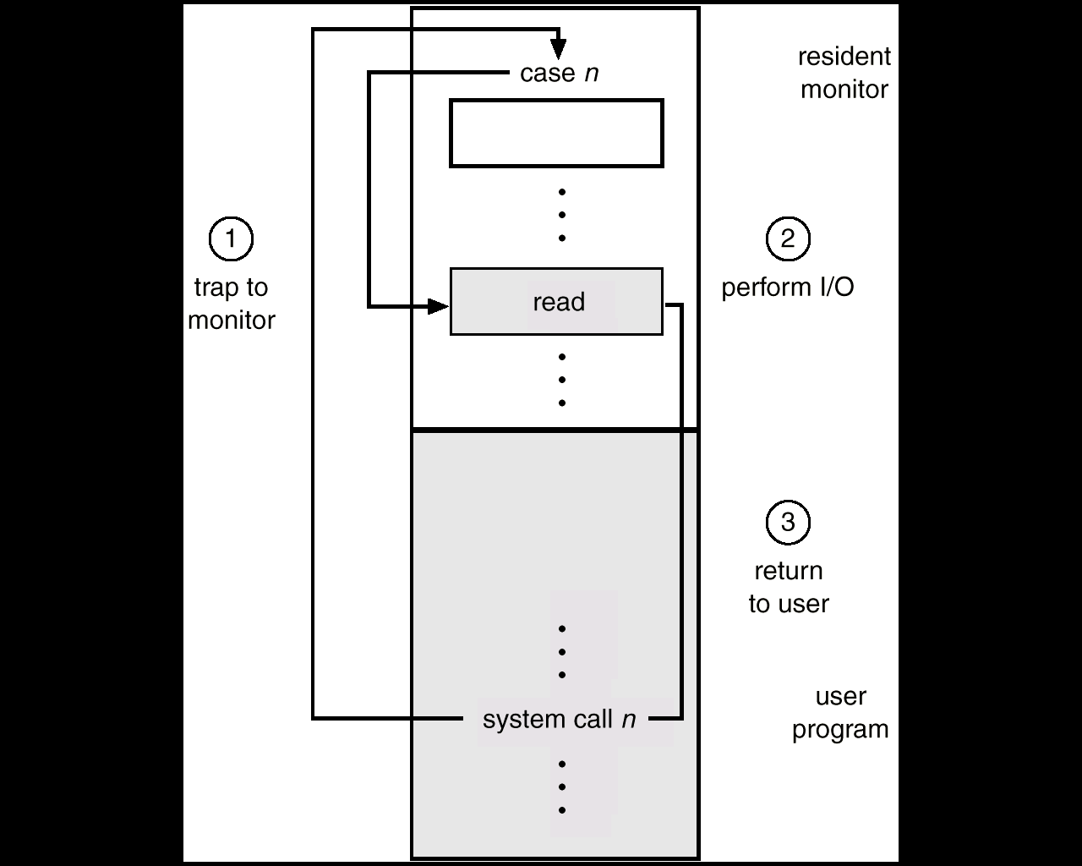
System Calls
A System Call is the main way a user program interacts with the Operating System.

Slide 17
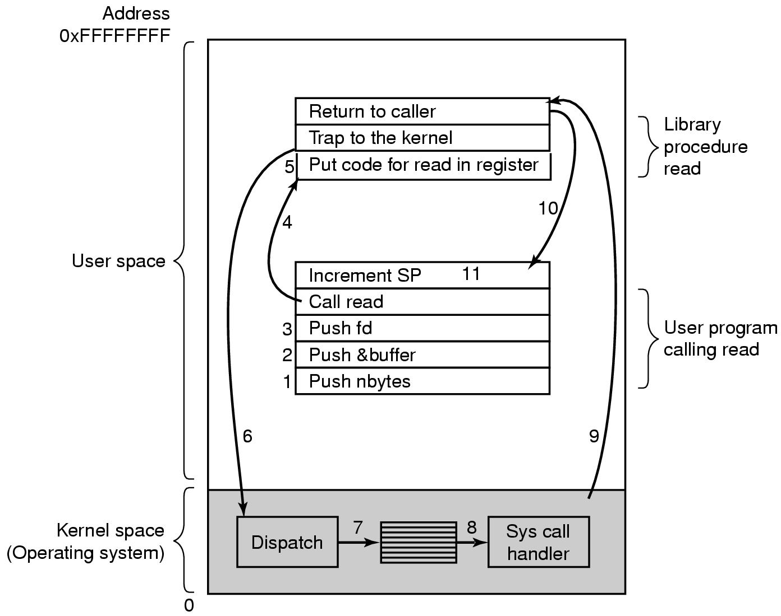
System Calls
HOW A SYSTEM CALL WORKS
Obtain access to system space
Do parameter validation
System resource collection ( locks on structures )
Ask device/system for requested item
Suspend waiting for device
Interrupt makes this thread ready to run
Wrap-up
Return to user
There are 11 (or more) steps in making the system call
read (fd, buffer, nbytes)
Linux API

Slide 18
System Call Implementation
Typically, a number associated with each system call
System-call interface maintains a table indexed according to these numbers
The system call interface invokes the intended system call in OS kernel and returns status of the system call and any return values
The caller need know nothing about how the system call is implemented
Just needs to obey API and understand what OS will do as a result call
Most details of OS interface hidden from programmer by API
Managed by run-time support library (set of functions built into libraries included with compiler)

Slide 19
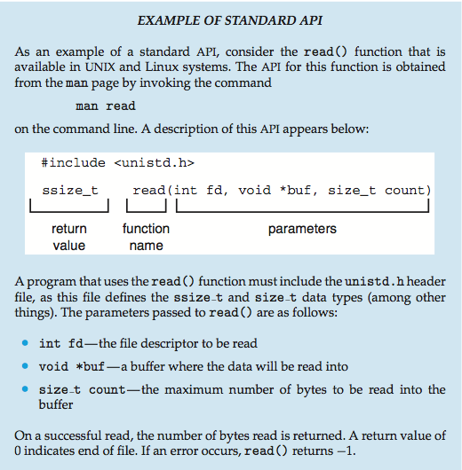
Example of Standard API

Slide 20
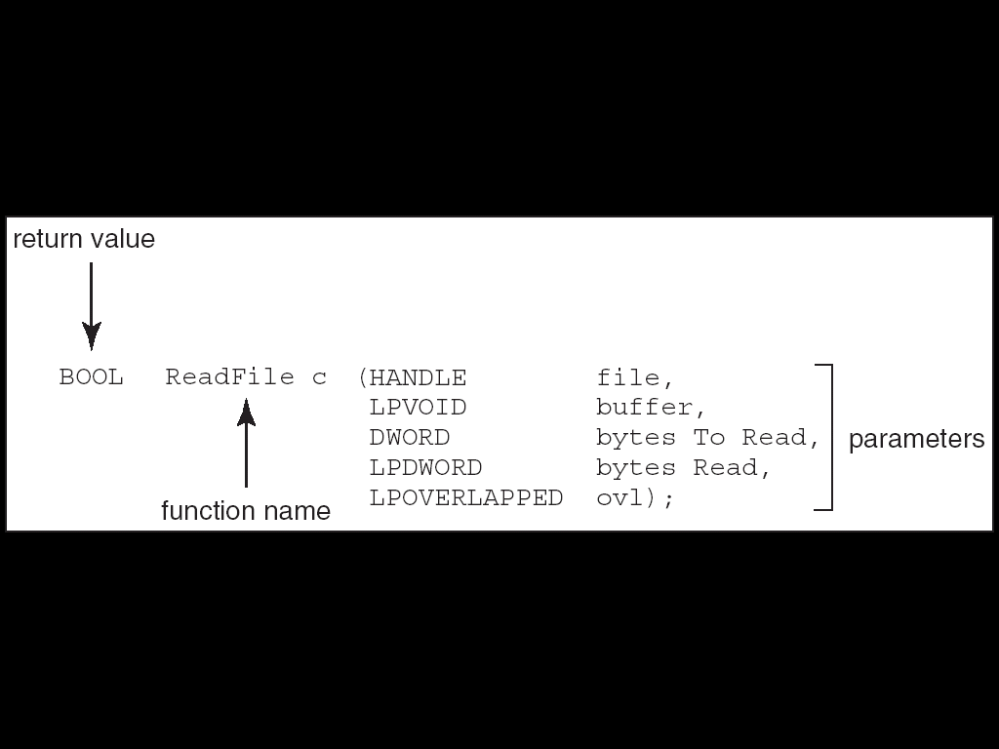
Example of Windows API
Consider the ReadFile() function in the program
Win32 API—a function for reading from a file.
A description of the parameters passed to ReadFile()
HANDLE file—the file to be read
LPVOID buffer—a buffer where the data will be read into and written from
DWORD bytesToRead—the number of bytes to be read into the buffer
LPDWORD bytesRead—the number of bytes read during the last read
LPOVERLAPPED ovl—indicates if overlapped I/O is being used

Slide 21
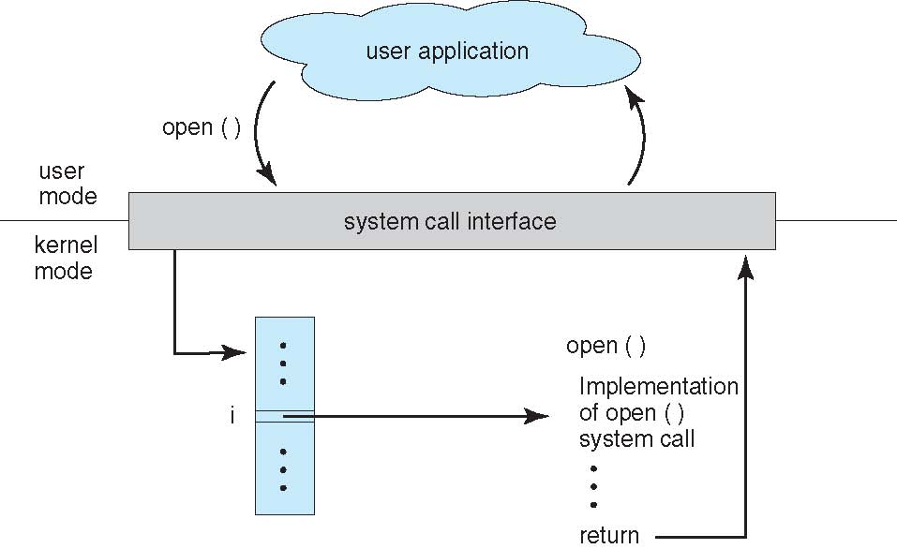
API – System Call – OS Relationship

Slide 22
System Call Parameter Passing
Often, more information is required than simply identity of desired system call
Exact type and amount of information vary according to OS and call
Three general methods used to pass parameters to the OS
Simplest: pass the parameters in registers
In some cases, may be more parameters than registers
Parameters stored in a block, or table, in memory, and address of block passed as a parameter in a register
This approach taken by Linux and Solaris
Parameters placed, or pushed, onto the stack by the program and popped off the stack by the operating system
Block and stack methods do not limit the number or length of parameters being passed

Slide 23
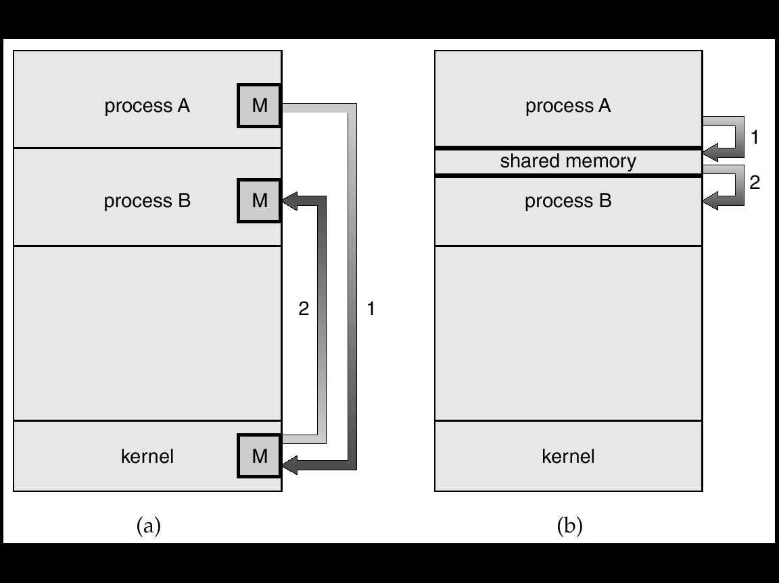
passing data between programs
Msg Passing
Shared Memory

Slide 24
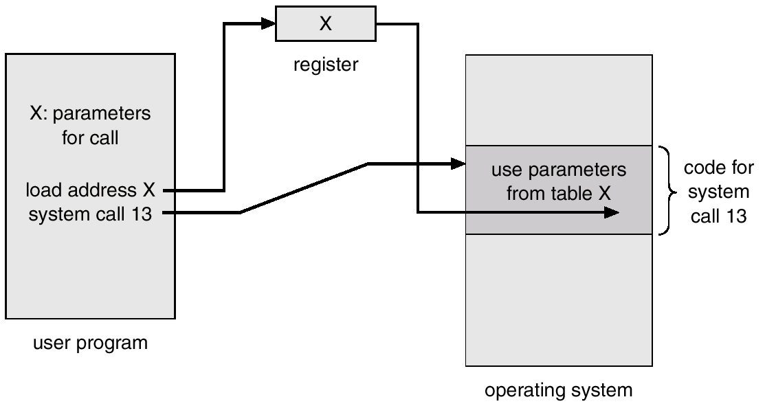
Passing of Parameters As A Table

Slide 25
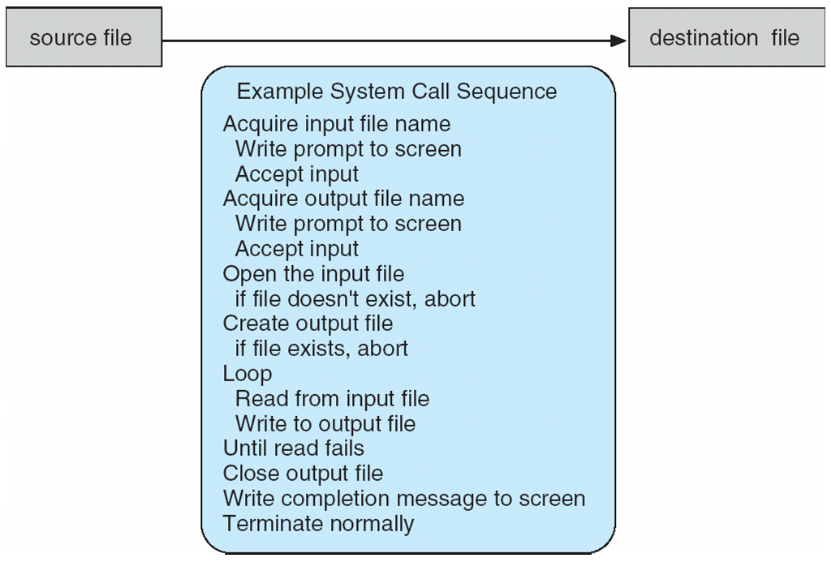
Example of System Calls
System call sequence to copy the contents of one file to another file

Slide 26
Send message from one processor to another
Source Program
Dest Program
Operations to be performed:
Check Permissions, Format Message
Enforce forward progress,
Handle interrupts
Prevent Denial Of Service (DOS)
and/or Deadlock
Traditional Approach:
Use a system call + OS Service
User-Level Code (With Libraries)
SysCall
SysCall
Message Service
Kernel (OS)
Code
Message Service
OS Service
Device Driver
Device Driver
Hardware Interface
Network
Hardware Interface
Hardware

Slide 27
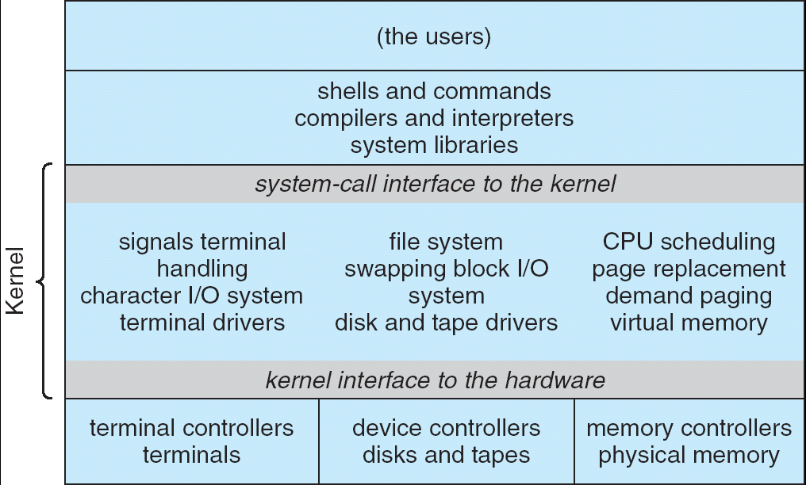
UNIX System Structure
Applications
User Mode
Standard Libs
Kernel Mode
Hardware

Slide 28
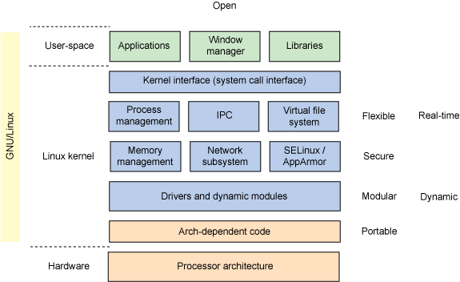
Linux Structure

Slide 29
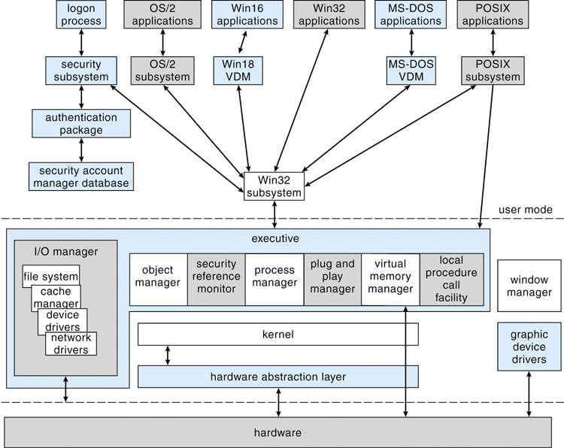
Microsoft Windows Structure

Slide 30
Major Windows Components
Hardware Abstraction Layer
Hides hardware chipset differences from upper levels of OS
Kernel Layer
Thread Scheduling
Low-Level Processors Synchronization
Interrupt/Exception Handling
Switching between User/Kernel Mode.
Executive
Set of services that all environmental subsystems need
Object Manager
Virtual Memory Manager
Process Manager
Advanced Local Procedure Call Facility
I/O manager
Cache Manager
Security Reference Monitor
Plug-and-Plan and Power Managers
Registry
Booting
Programmer Interface: Win32 API

Slide 31
Types of System Calls
Process control
File manipulation
Device manipulation
Information maintenance
Communications
Protection

Slide 32
Types of System Calls
Process control
create process, terminate process
end, abort
load, execute
get process attributes, set process attributes
wait for time
wait event, signal event
allocate and free memory
Dump memory if error
Debugger for determining bugs, single step execution
Locks for managing access to shared data between processes

Slide 33
Types of System Calls
File management
create file, delete file
open, close file
read, write, reposition
get and set file attributes
Device management
request device, release device
read, write, reposition
get device attributes, set device attributes
logically attach or detach devices

Slide 34
Types of System Calls
Information maintenance
get time or date, set time or date
get system data, set system data
get and set process, file, or device attributes
Communications
create, delete communication connection
send, receive messages if message passing model to host name or process name
From client to server
Shared-memory model create and gain access to memory regions
transfer status information
attach and detach remote devices

Slide 35
Types of System Calls
Protection
Control access to resources
Get and set permissions
Allow and deny user access

Slide 36
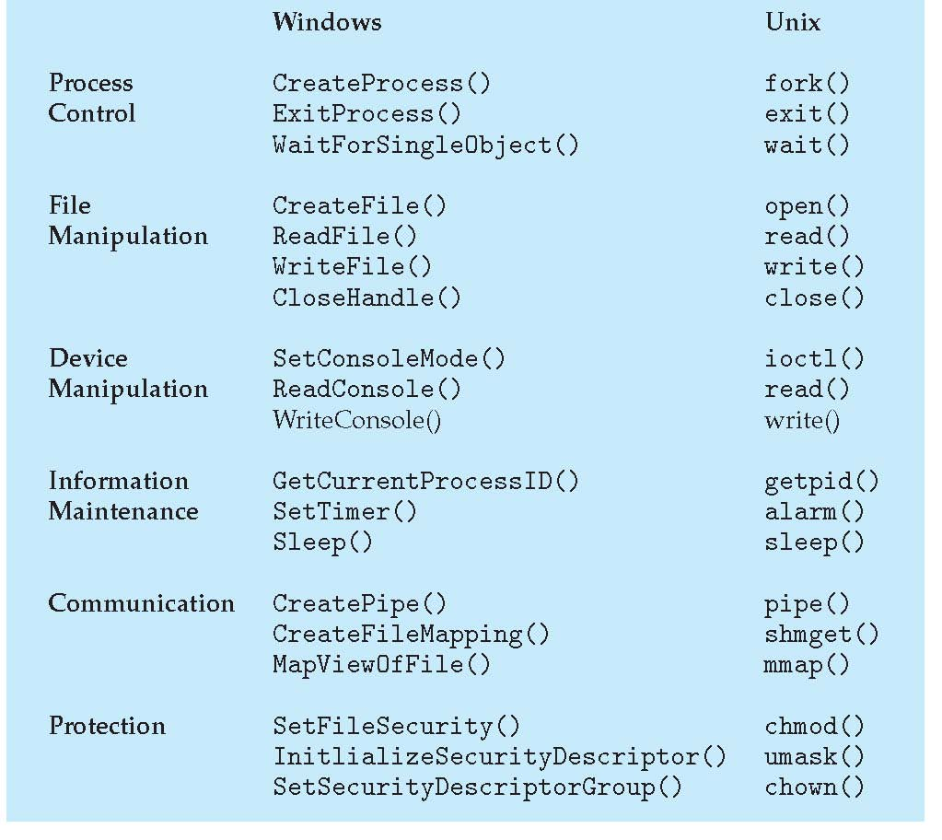
Examples of Windows and Unix System Calls

Slide 37
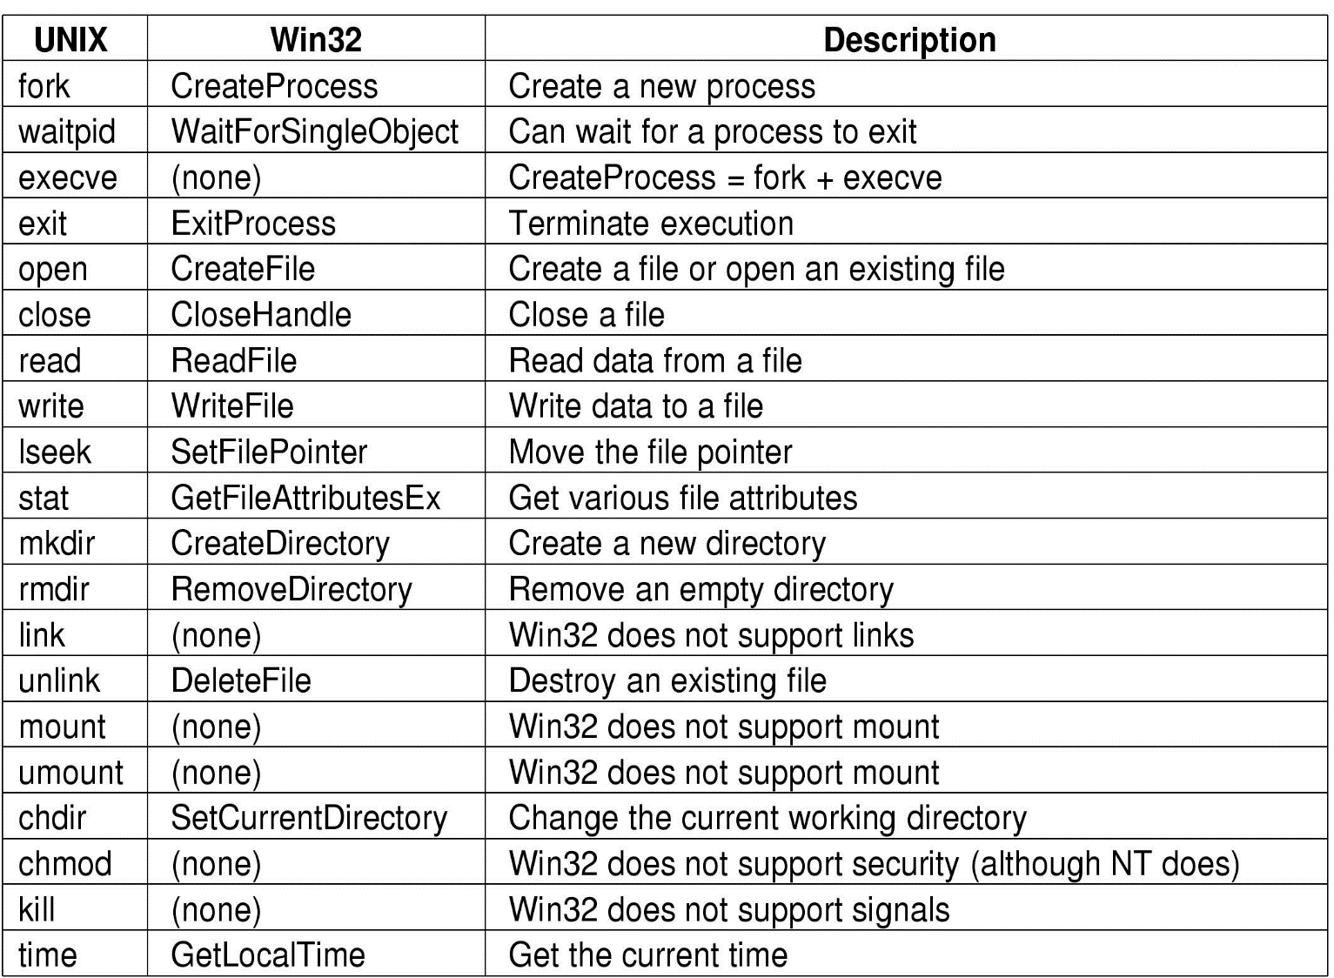

Slide 38
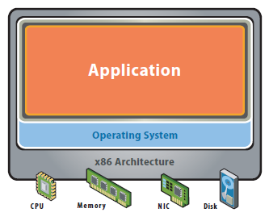
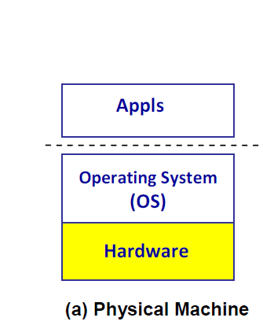
Initial Hardware Model
The host machine is equipped with the physical hardware
e.g. a desktop with x-86 architecture running its installed Windows OS
All applications access hardware resources (i.e. memory, i/o) through system calls to operating system (privileged instructions)

Slide 39
Single OS image per machine
Software and hardware tightly coupled
Running multiple applications on same machine
Underutilized resources
Inflexible and costly infrastructure

Slide 40
Advantages
Design is decoupled (i.e. OS people can develop OS separate of Hardware people developing hardware)
Hardware and software can be upgraded without notifying the Application programs

Slide 41
Disadvantages
Application compiled on one ISA will not run on another ISA..
Applications compiled for Mac use different operating system calls then application designed for windows.
ISA’s must support old software
Can often be inhibiting in terms of performance
Since software is developed separately from hardware..
Software is not necessarily optimized for hardware.

Slide 42
Architecture & Interfaces Architecture: formal specification of a system’s interface and the logical behavior of its visible resources.
API
Applications
Libraries
System Calls
ABI
Operating
System
ISA
System ISA
User ISA
Hardware
API – Application Programming Interface
ABI – Application Binary Interface
ISA – Instruction Set Architecture

Slide 43
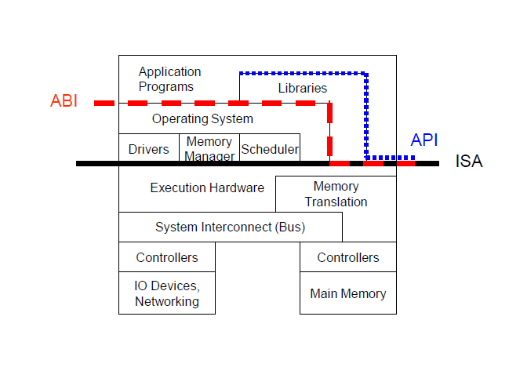
Architecture, Implementation Layers
Architecture
Functionality and Appearance of a computer system but not implementation details
Level of Abstraction = Implementation layer ISA, ABI, API

Slide 44
Architecture, Implementation Layers
Implementation Layer : ISA
Instruction Set Architecture
Divides hardware and software
Concept of ISA originates from IBM 360
Various prices, processing power, processing unit, devices
But guarantee a software compatibility
User ISA and System ISA

Slide 45
Architecture, Implementation Layers
Implementation Layer : ABI
Application Binary Interface
Provides a program with access to the hardware resource and services available in a system
Consists of User ISA and System Call Interfaces

Slide 46
Architecture, Implementation Layers
Implementation Layer : API
Application Programming Interface
Key element is Standard Library ( or Libraries )
Typically defined at the source code level of High Level Language
clib in Unix environment : supports the UNIX/C programming language

Slide 47
Multimode System
The concept of modes of operation in operating system can be extended beyond the dual mode. This is known as the multimode system. In those cases the more than 1 bit is used by the CPU to set and handle the mode.
An example of the multimode system can be described by the systems that support virtualization. These CPU’s have a separate mode that specifies when the virtual machine manager (VMM) and the virtualisation management software is in control of the system.
For these systems, the virtual mode has more privileges than user mode but less than kernel mode.

Slide 48
What is virtualization?
Virtualization -- the abstraction of computer resources.
Virtualization hides the physical characteristics of computing resources from their users, be they applications, or end users.
This includes making a single physical resource (such as a server, an operating system, an application, or storage device) appear to function as multiple virtual resources; it can also include making multiple physical resources (such as storage devices or servers) appear as a single virtual resource.

Slide 49
Virtualization
Similar to Abstraction but doesn’t always hide low layer’s details
Real system is transformed so that it appears to be different
Virtualization can be applied not only to subsystem, but to an Entire Machine → Virtual Machine

Slide 50
Virtualization
Applications or OS
Application uses virtual disk as Real disk
Virtualized
Disk
Virtualization
File
File
Abstraction
Real Disk

Slide 51
Virtualization, in computing, is the creation of a virtual (rather than actual) version of something, such as a hardware platform, operating system, storage device, or network resources.
Virtualization is the process by which one computer hosts the appearance of many computers.
It is used to improve IT throughput and costs by using physical resources as a pool from which virtual resources can be allocated.

Slide 52
VIRTUALIZATION BENEFITS
Sharing of resources helps cost reduction
Isolation: Virtual machines are isolated from each other as if they are physically separated
Encapsulation: Virtual machines encapsulate a complete computing environment
Hardware Independence: Virtual machines run independently of underlying hardware
Portability: Virtual machines can be migrated between different hosts.
Cross platform compatibility
Increase Security
Enhance Performance
Simplify software migration

Slide 53
What is “Machine”?
2 perspectives
From the perspective of a process
ABI provides interface between process and machine
From the perspective of a system
Underlying hardware itself is a machine.
ISA provides interface between system and machine

Slide 54
System/Process Virtual Machines
Can view virtual machine as:
Process virtual machine
Virtual machines can be instantiated for a single program (i.e. similar to Java)
Virtual machine terminates when process terminates.
System virtual machine (i.e. similar to cygwin)
Full execution environment that can support multiple processes
Support I/O devices
Support GUI

Slide 55
Virtual Machines
A virtual machine takes the layered approach to its logical conclusion. It treats hardware and the operating system kernel as though they were all hardware.
A virtual machine provides an interface identical to the underlying bare hardware.
The operating system creates the illusion of multiple processes, each executing on its own processor with its own (virtual) memory.

Slide 56
The resources of the physical computer are shared to create the virtual machines.
CPU scheduling can create the appearance that users have their own processor.
Spooling (simultaneous peripheral operations online) and a file system can provide virtual card readers and virtual line printers.
A normal user time-sharing terminal serves as the virtual machine operator’s console.

Slide 57
VM types
Native VM
Hosted VM
Dual mode VM

Slide 58
Native VM
The VM can be provisioned to any hardware system.
Virtual software placed between underlying machine and conventional software
Conventional software sees different ISA from the one supported by the hardware
The VM is built with virtual resources managed by a guest OS to run a specific application. Between the VMs and the host platform, we need to deploy a middleware layer called a Virtual Machine Monitor (VMM) .

Slide 59
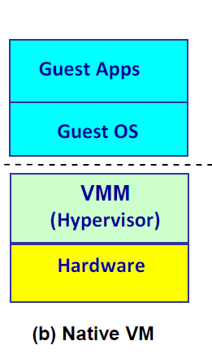
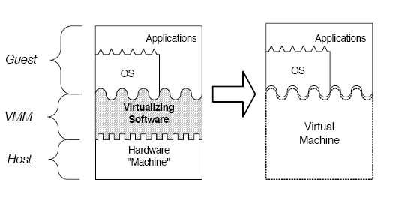

Slide 60
Figure b shows a native VM installed with the use a VMM called a hypervisor at the privileged mode.
For example, the hardware has a x-86 architecture running the Windows system. The guest OS could be a Linux system and the hypervisor is the XEN system developed at Cambridge University.
This hypervisor approach is also called bare-metal VM, because the hypervisor handles the bare hardware (CPU, memory, and I/O) directly.

Slide 61
Virtualization process involves:
Mapping of virtual resources (registers and memory) to real hardware resources
Using real machine instructions to carry out the actions specified by the virtual machine instructions

Slide 62
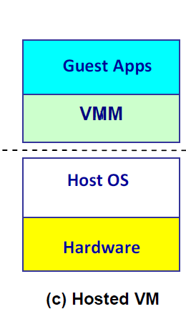
Hosted VM
Another architecture is the host VM shown in Fig. (c). Here the VMM runs with a non-privileged mode. The host OS need not be modified.

Slide 63
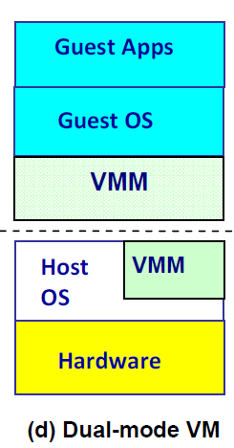
Dual Mode VM
The VM can be also implemented with a dual mode as shown in Fig. (d).

Slide 64
Part of VMM runs at the user level and another portion runs at the supervisor level. In this case, the host OS may have to be modified to some extent.
Multiple VMs can be ported to one given hardware system, to support the virtualization process.
The VM approach offers hardware-independence of the OS and applications.
The user application and its dedicated OS could be bundled together as a virtual appliance, that can be easily ported on various hardware platforms.

Slide 65
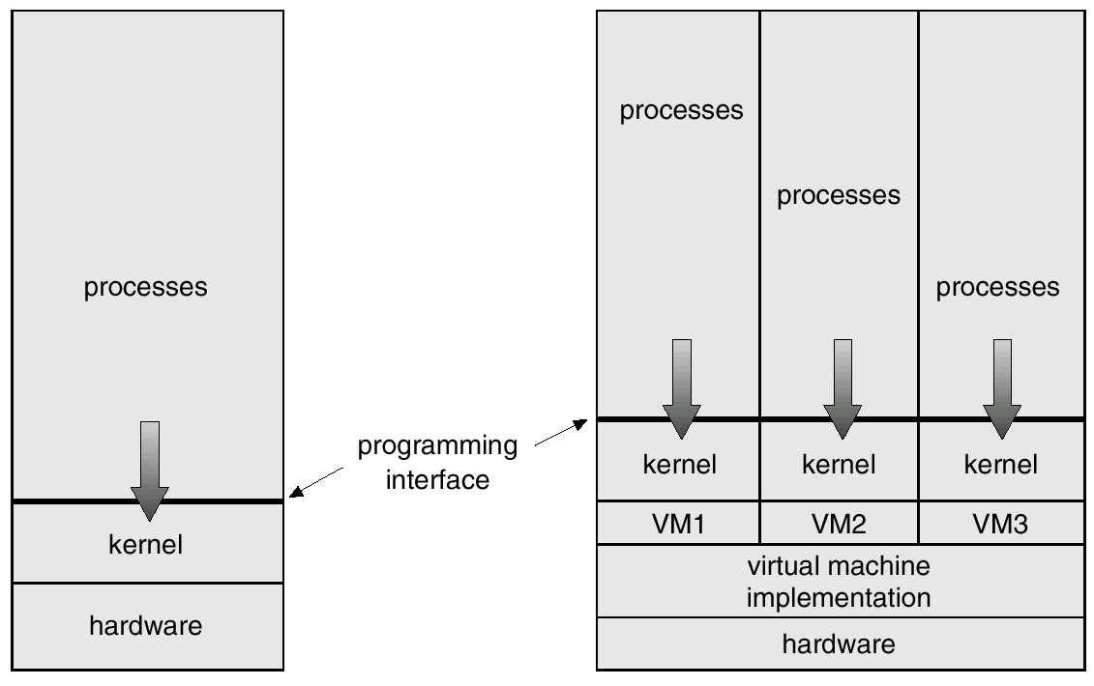
System Models

Slide 66
Advantages/Disadvantages of Virtual Machines
The virtual-machine concept provides complete protection of system resources since each virtual machine is isolated from all other virtual machines. This isolation, however, permits no direct sharing of resources.
A virtual-machine system is a perfect vehicle for operating-systems research and development. System development is done on the virtual machine, instead of on a physical machine and so does not disrupt normal system operation.
The virtual machine concept is difficult to implement due to the effort required to provide an exact duplicate to the underlying machine.

